Slide 1

System aberration correction for whole brain imaging with a light sheet microscope
M.Caroline Müllenbroich, Ludovico Silvestri, Leonardo Sacconi & Francesco S. Pavone

Slide 2
Outline
Adaptive Optics
Introduction
Wavefront sensorless aberration correction
Random Search Algorithm
Microscope Setup
Optical setup
Sample preparation
Software management
Data management
Results
System aberration correction
Brain imaging
Outlook

Slide 3
Adaptive Optics

Slide 4
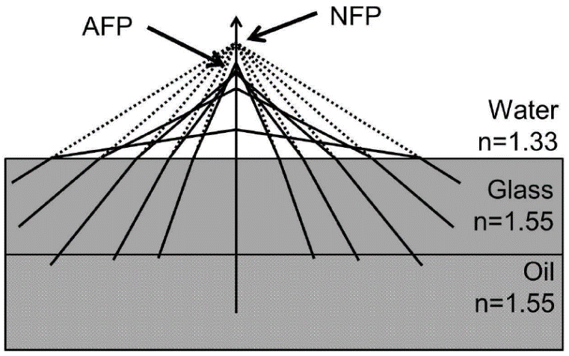
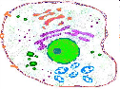
Compensation of optical aberrations at large imaging depths
Principle: use of pre-shaped wavefront with equal but opposite distortion to that introduced by the sample
Wavefront generated by deformable membrane mirror (DMM)
DMM shape determined by random search optimisation algorithm

Slide 5
Start: initial shape from LUT
Select Random Actuator
Selection weighed with Gaussian distribution choosing central actuators more often than those in periphery
Change Actuator Voltage
Change limited by percentage of total actuator stroke
Iterations
Yes
Record Merit Factor
Improvement?
No
Voltage change is accepted
Voltage reverts to previous value
At least a 100 successful iterations?
No
Yes
SOLUTION

Slide 6
Improvement in
MF within last n iterations?
Yes
No
Continue optimisation
Activate compensation:
Apply best mirror shape
Measure MF for m iterations
Calculate mean and σ of m measurements
Keep best MF
Replace best MF with mean
Resume optimisation

Slide 7
post attachment
reflective membrane
actuator
substrate

Slide 8
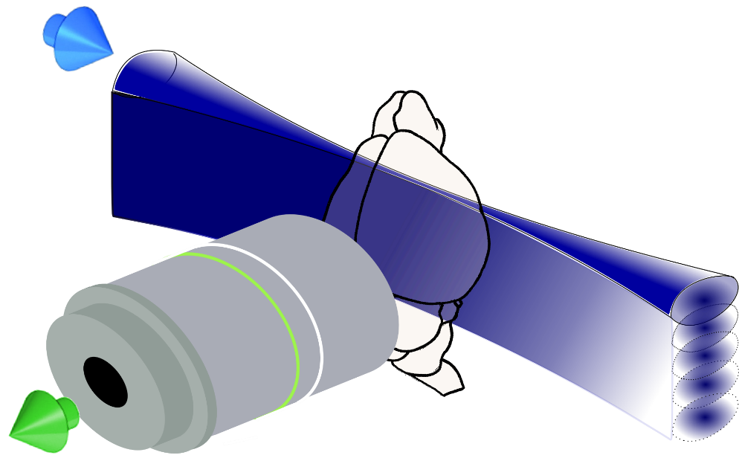
Digitally scanned light sheet microscope
Single axis scan creates light sheet
Projection into specimen at 90° to detection objective

Slide 9
galvo
Illumination
Light-sheet generation
Detection
561 nm
515 nm
491 nm
445 nm
405 nm
f 200
f 50
f 140
f 350
v
f 100
Camera
f 200
f 180
DMM
LP 552
PBS
LP 503
filter
wheel
LP 466
f 350
f 150
f 100
LP 427
f 150
LM
f 50
AOTF
I1
I2
galvo
f 200

Slide 10
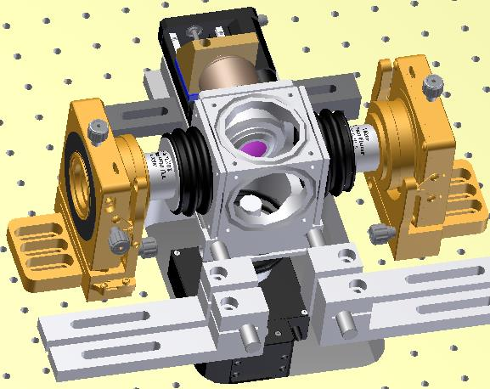
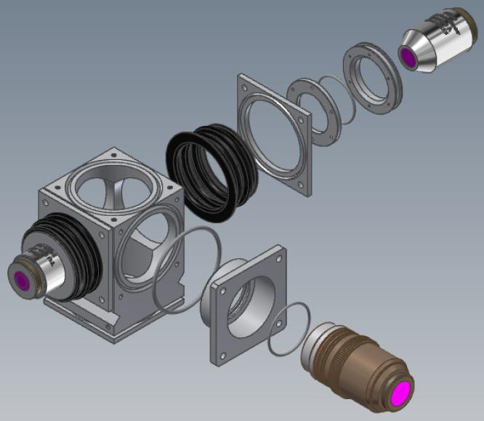
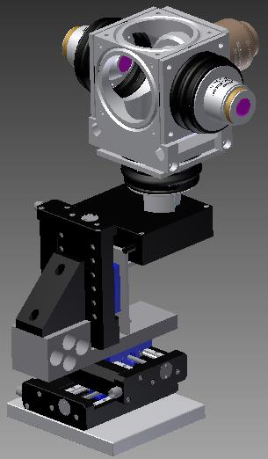
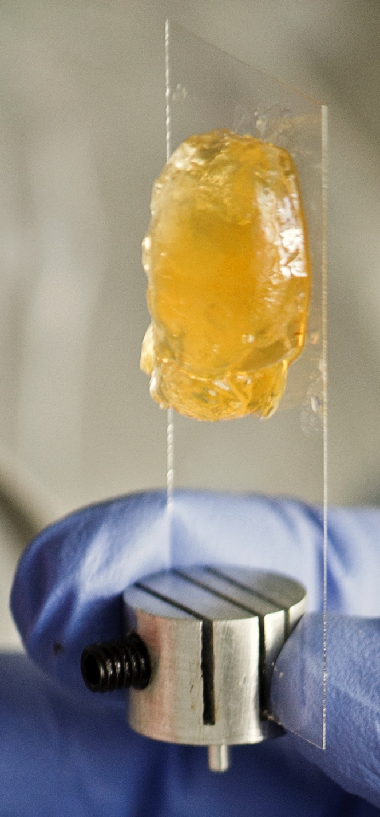
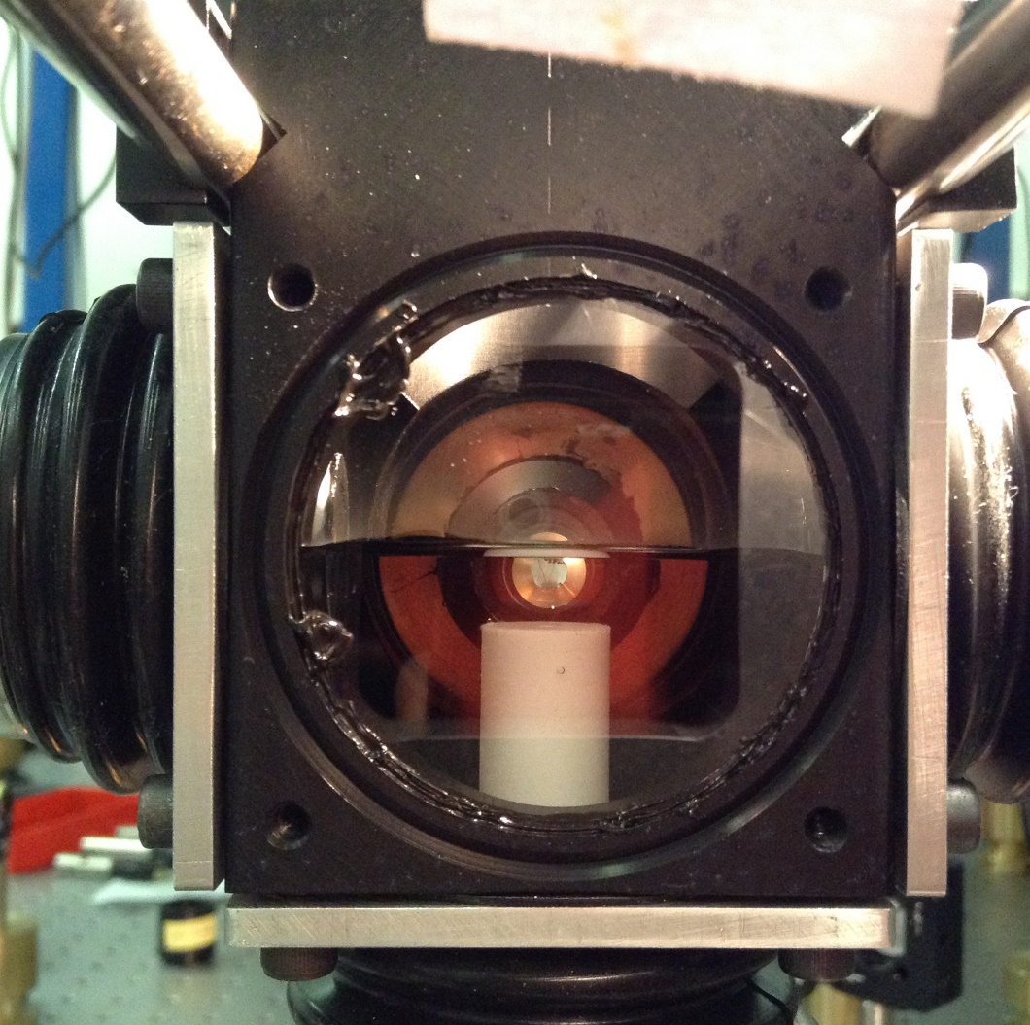
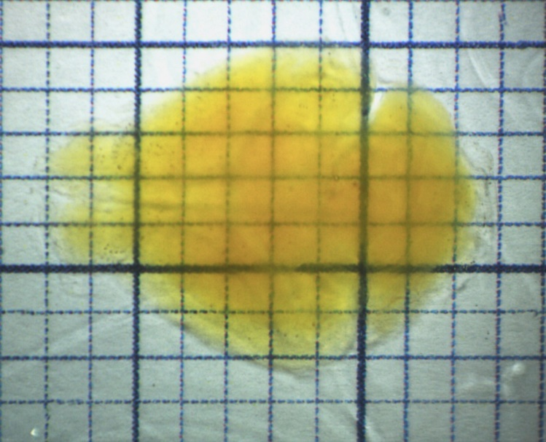
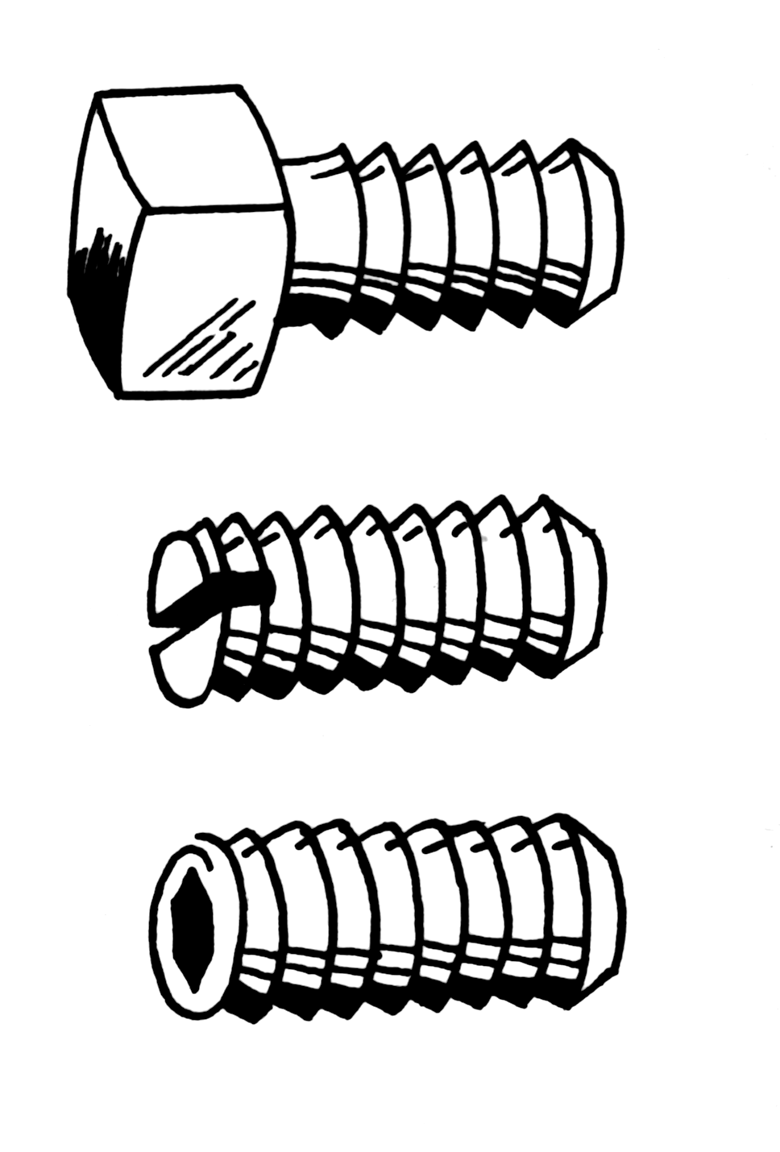
z
x

Slide 11
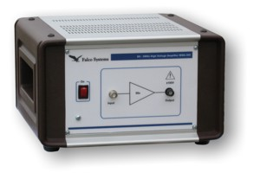
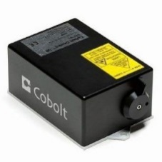
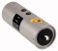
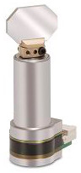
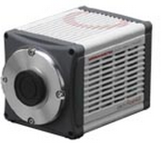
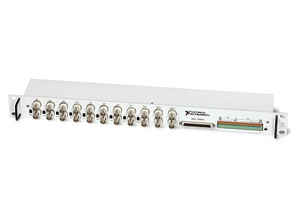
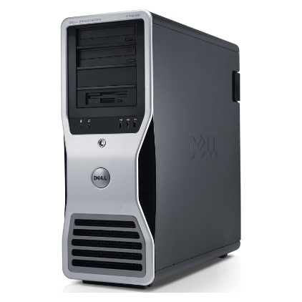
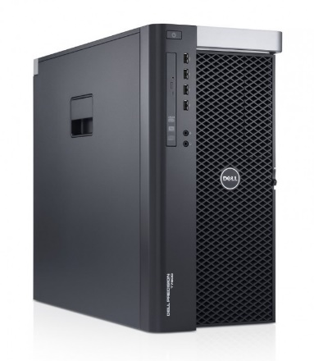
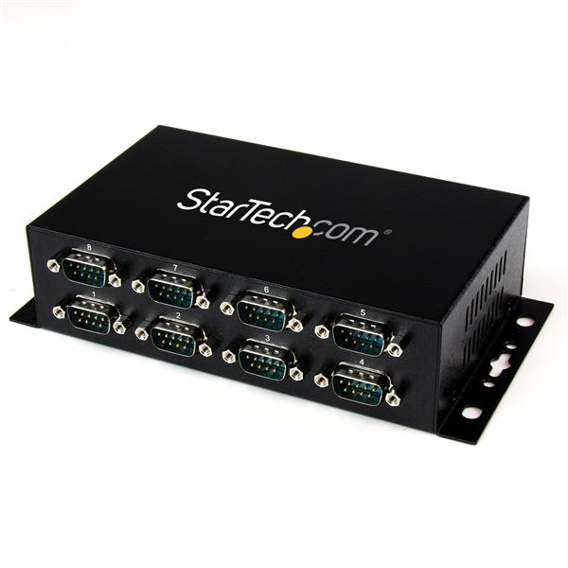
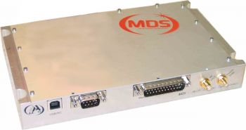
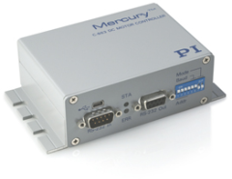

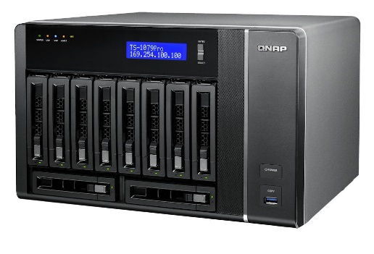
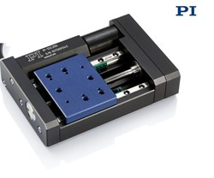
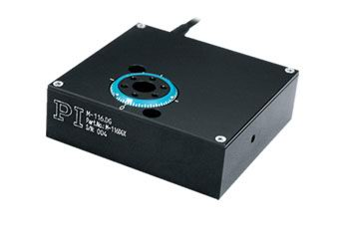
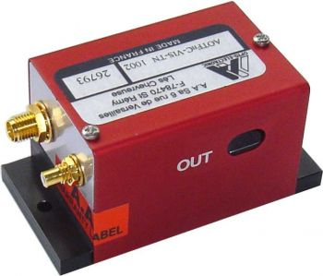
Connections
Pulse amplifier
EOM
Galvo 1
1 Gb/s ethernet
405 nm laser
10 Gb/s SFP+
Camera
DAQ
Galvo 2
445 nm laser
CameraLink
Co-axial
491 nm laser
HV co-axial
PC2
USB
RS-232 Hub
515 nm laser
RS232 Daisy Chain
PC1
RS-232
561 nm laser
RF co-axial
Internal bus
RF generator
Servo motor
Servo motor
Servo motor
Servo motor
AOTF
Supercomputing Centre
NAS
Translation x
Translation y
Translation z
Rotation stage

Slide 12
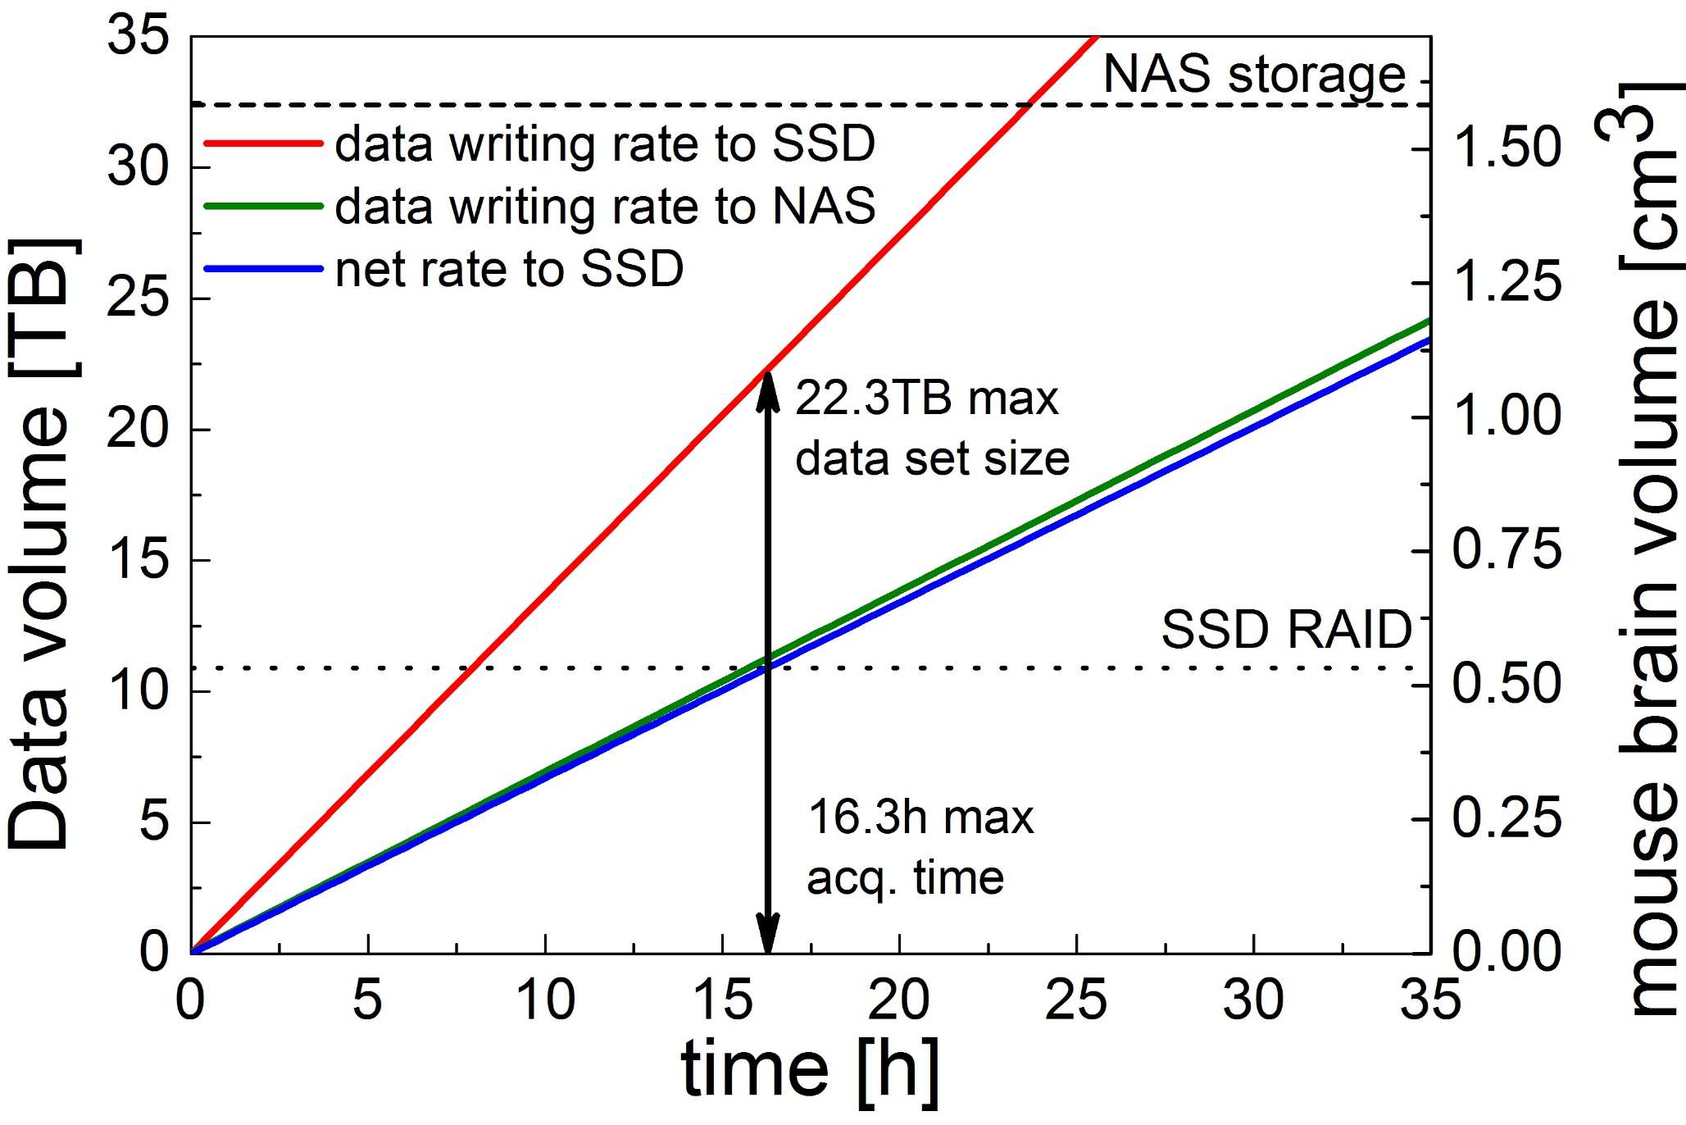
A
B
Camera
10 Gb Optical fibres
Remote repository
CINECA
CameraLink
board
10Gb network card
System
bus
Network-attached storage
32.4 TB
Raw data stream
Local SSD RAID 0
10.9TB
Data conversion stream
Transfer to remote repository
Workstation
Laboratory

Slide 13
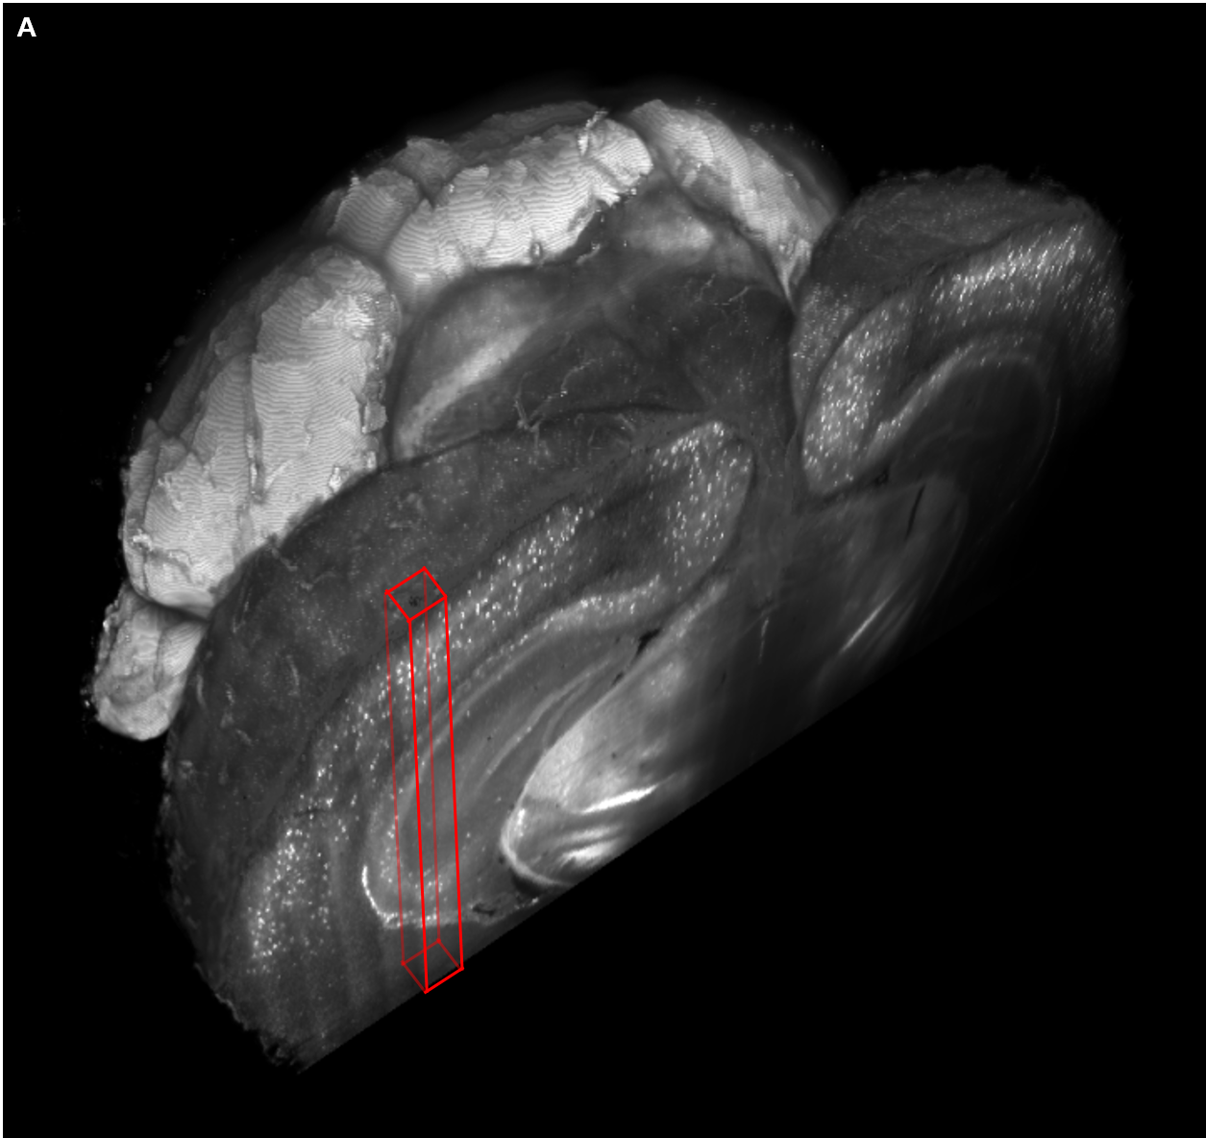
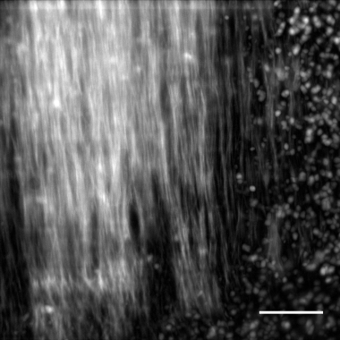
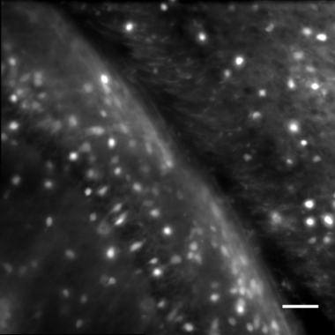
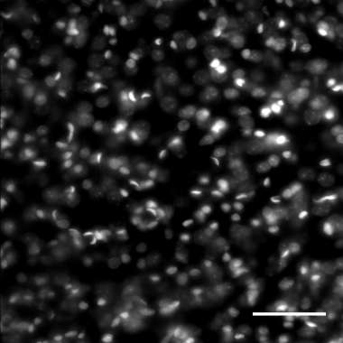
A
B
C
PV
PV
GAD
PI
D
GAD
E
PI

